Slide 1
Capstone Project YES Bank stock closing price prediction By: Manisha Dhanuka

Slide 2
What to expect in next few slides:
Problem Statement
Data overview
Exploratory Data Analysis
Feature Selection
ETS Decomposition
Anomalies Detection
Model Application and Evaluation
Stationarity Check
SARIMA Model
Final Forecast

Slide 3
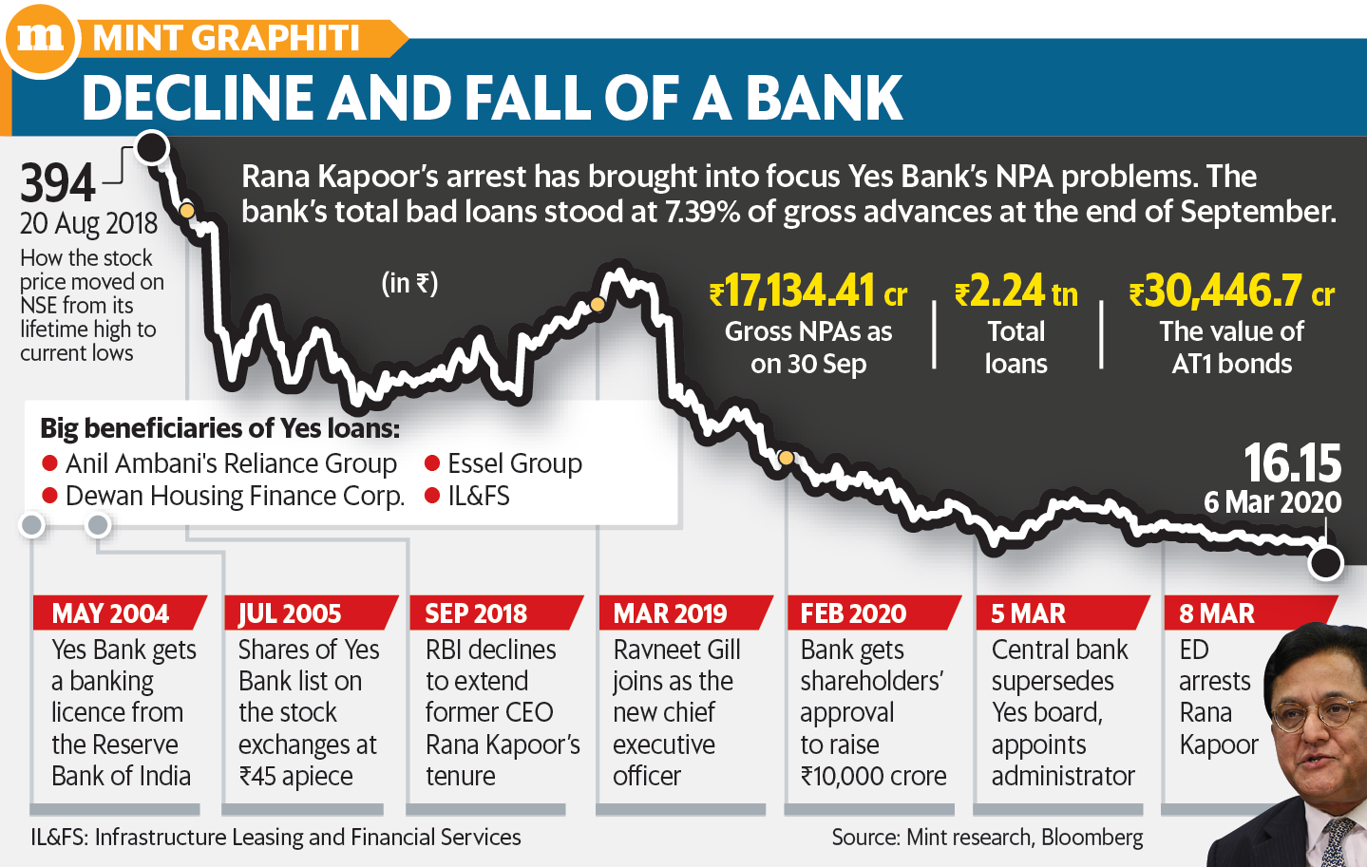
Problem Statement
Yes Bank is an Indian bank headquartered in Mumbai, It offers wide range of differentiated products with respect to retail banking and asset management services. Since 2018, it has been in the news because of the fraud case involving Rana Kapoor, the founder. Owing to the fact, it was interested to see how that impacted the stock price of the company and whether time series models or any other predictive models can do justice to such situations

Slide 4

Data Overview:
The dataset we worked with has monthly stock prices of the bank since its inception, and includes opening, closing, high and low prices of every month.

Slide 5
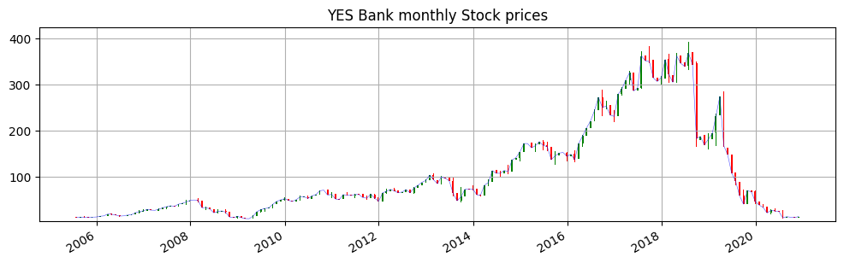
Exploratory Data Analysis

Slide 6
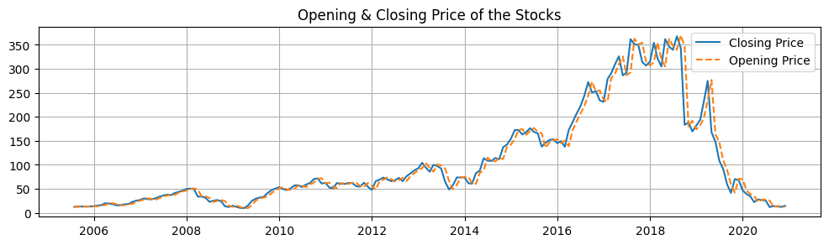
Opening & Closing price of the stocks nearly follow same trend, thus it seems that there was no drastic change within a month.

Slide 7
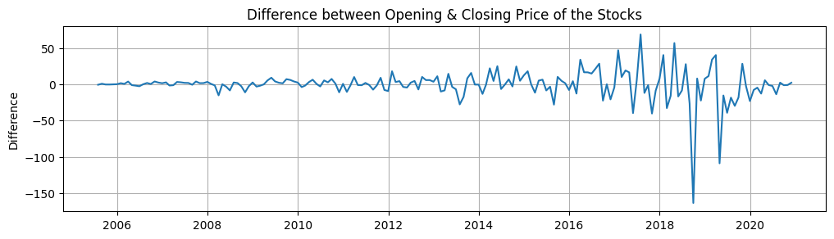
But on plotting the difference, it seems that there is significant difference during 2018 last quarter, in particular September,2018, that too a decrease of 163 INR

Slide 8
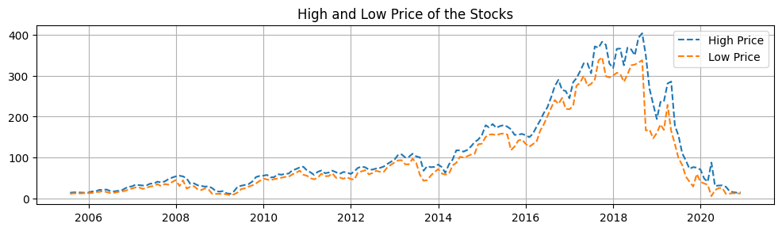
Further analyzing the high & low price of the stock, we found that gap between these two prices starts increasing after 2017 i.e. the price monthly fluctuation was high within these years.

Slide 9
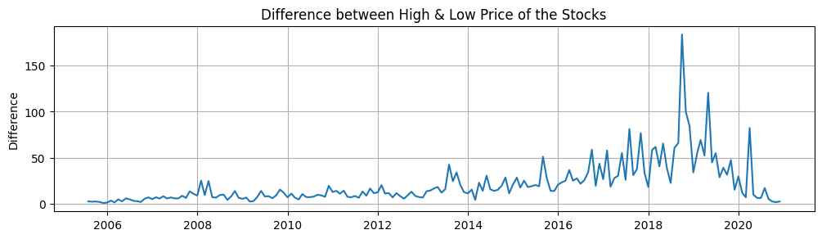
Also, the difference between high and low prices of the September, 2018 is nearly 183 INR, which further strengthens our intuition.

Slide 10
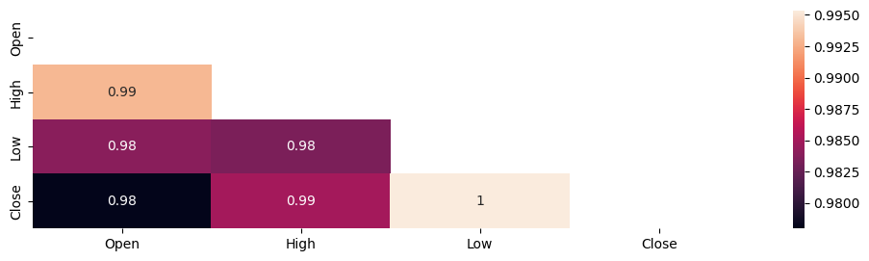
Feature selection based on correlation:
There was a high bivariate collinearity as well as multivariate collinearity too. Dropped all other columns except Close, which is our target variable.

Slide 11
ETS Decomposition:
Time series decomposition is a process by which we separate a time series into its components: trend, seasonality, and residuals.
Trend: The trend represents the slow-moving changes in a time series. It is responsible for making the series gradually increase or decrease over time.
Seasonality: The seasonality component represents the seasonal pattern in the series. The cycles occur repeatedly over a fixed period of time.
Residuals: The residuals represent the behavior that cannot be explained by the trend and seasonality components. They correspond to random errors, also termed white noise.

Slide 12
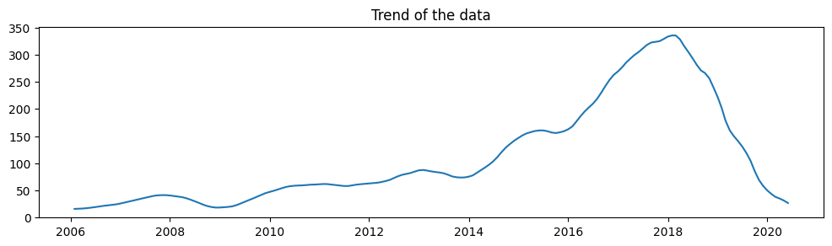
Trend Analysis:
There is an overall increasing trend but after 2018 there is a decreasing trend.

Slide 13
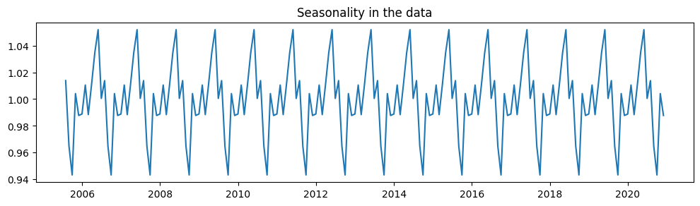
Seasonality Analysis:
There is a seasonality component also, every year the price of stock decreases in October, then starts rising reaching it's peak in June and then again starts decreasing.

Slide 14
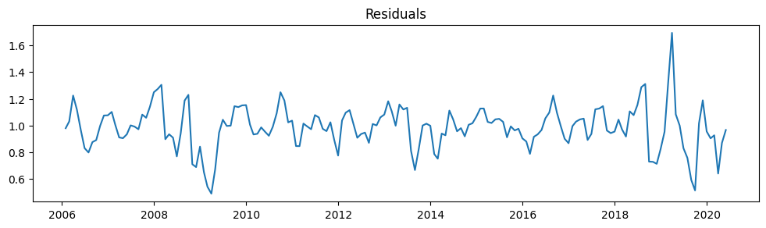
Residual Analysis:
The residual component is just random noise mean at 1 with standard deviation of about 0.4

Slide 15
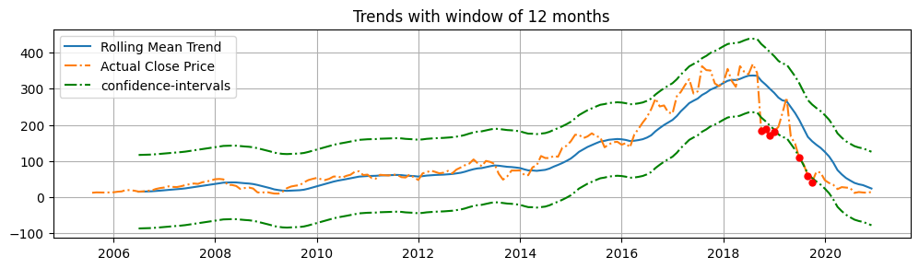
Anomalies using confidence interval:

Slide 16
Do other factors affect the stock prices?
As we see in the bivariate analysis of the open & stock prices , we saw a great difference in the values during 3rd quarter of 2018 specifically Sept, 2018
Same case in analysis of high & low values of data during this period.
The anomaly detection using confidence intervals also supports this.
Also the Anomaly detection using Isolation Forest marks the month June & July as anomalies.
This was the time during which the founder of YES bank was charged with the corruption charges. Thus, Clearly that factor is somehow deviating the stock price from its trend.

Slide 17
Applying Model:
Through ETS Decomposition, we realized there was some seasonal component in play but the contribution was still meagre, thus trying both double and triple exponential smoothing for the forecast. Also, we are going to try with two different horizons i.e. 6 months and 12 months .
So, the model we tried:
DES_6 – Double Exponential Smoothing (6 month horizon)
DES_12 – Double Exponential Smoothing (12 month horizon)
TES_6 – Triple Exponential Smoothing (6 month horizon)
TES_12–Triple Exponential Smoothing (12 month horizon)

Slide 18
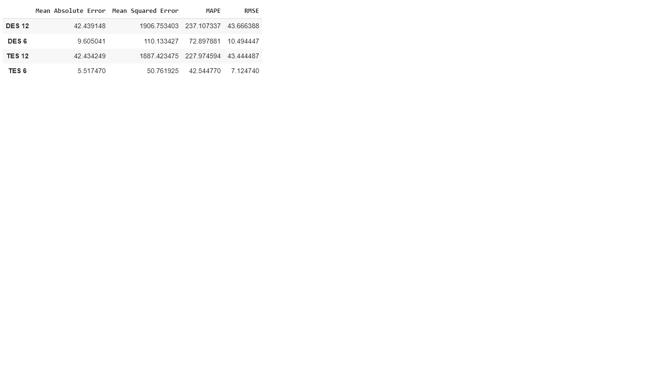
Models Evaluation:
As we can see the triple exponential model with 6 month horizon was working best among all these in predicting the test data.

Slide 19
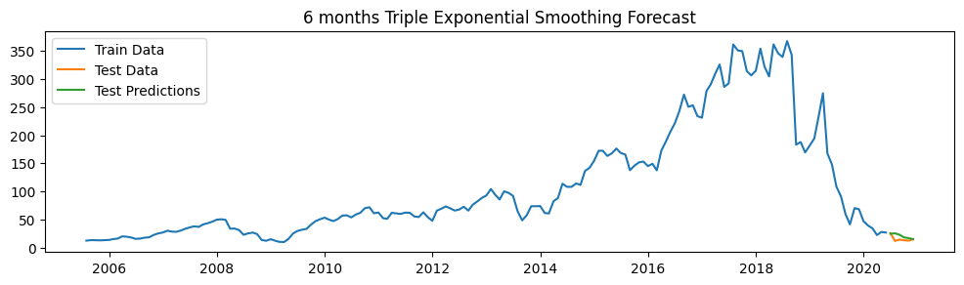

Slide 20
Stationarity Check:
Stationarity means the statistical properties of the data like mean, variance and autocorrelation remains constant over time. Many models like MA model, AR model etc. assumes stationarity because if data is not stationary it means its properties are continuously changing, then how can we derive a function which predicts the present value on the basis of past values when the coefficients are changing.
We used Augmented Dickey Fuller Test to check for the stationarity of data.
Null Hypothesis : Data is not stationary
Alternative Hypothesis: Data is stationary
Data was not stationary which we can expect through the ETS decomposition. We make it stationary by applying transformations.

Slide 21
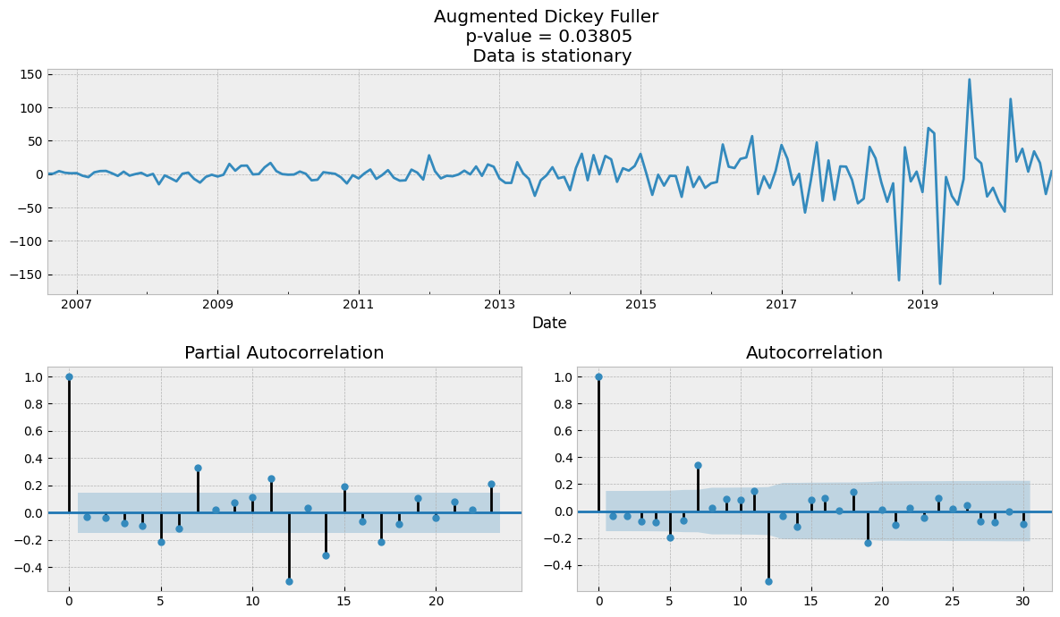

Slide 22
Continued….
Data becomes stationary after 1 differencing and 1 seasonal differencing . Thus, we can apply SARIMA model using d= 1 and D= 1
Since both ACF plots and PACF plots show significant correlated lags. Thus, it is neither only Moving Average Problem nor only Autoregression Problem. SARIMA model would have been better ML model to predict the data.
We fitted many SARIMA models and try to find the best parameters among them using their AIC score. Higher AIC, better the model is.

Slide 23
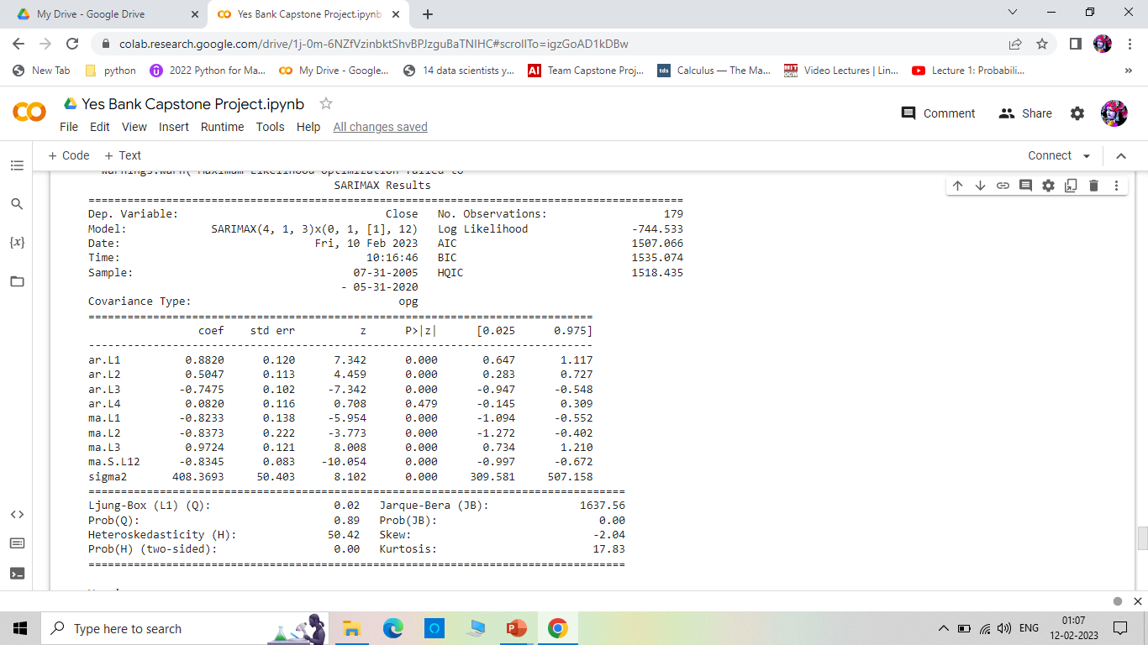
Best SARIMAX Model:

Slide 24
Further Analysis:
AIC is a comparison tool. So, we are just comparing the values fitted on our given order. But what if the order we provided are all not good? That’s why we do residual analysis.
Ideally, the residuals look like white noise, as it would mean that any difference between the predicted values and actual values are due to randomness. Therefore, the residuals must be uncorrelated and independently distributed. We can assess those properties by studying the Q-Q plot and running the Ljung-Box test .If the analysis leads us to conclude that the residuals are completely random, then we have a model ready for forecasting. Otherwise, we must try a different set of values for p and q, and start the process over.

Slide 25
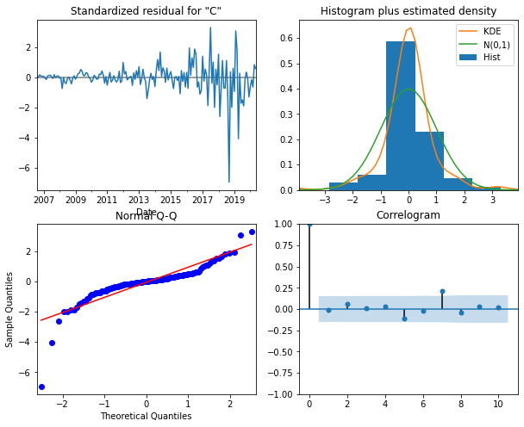
Residual Analysis using QQ plot:
From the graphs on right , we can see that residuals more or less follows Normal Distribution.
Also correlogram shows no correlation, which was further confirmed by Ljung Box Test

Slide 26
SARIMAX Model Evaluation:
Mean Absolute Error - 24.63719088000143,
Mean Squared Error - 816.7317743991939,
MAPE - 173.61861835827114
Clearly, Triple Exponential Smoothing model worked far better than SARIMA model.
Thus, our final forecast is given by triple Exponential Smoothing.

Slide 27
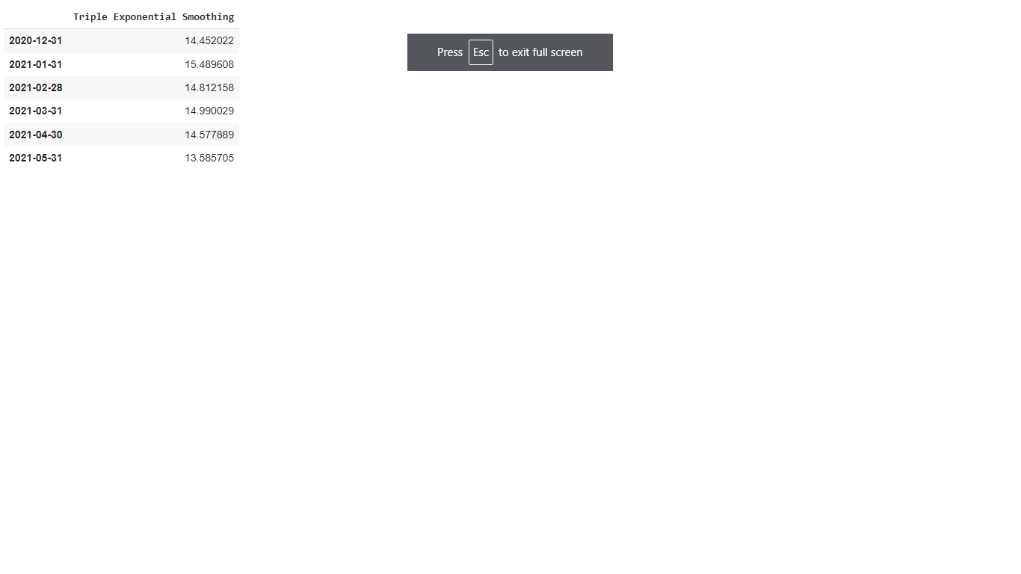
Final Model Forecast:

Slide 28
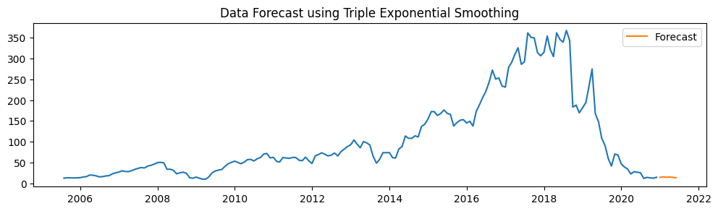

Slide 29
Thank You

